Slide 1


Regression model for the quark-gluon plasma fireball size
Team 28: Fireball
Mike McNelis and Seyed Sabok-Sayr
5/31/2020
The Erdős Institute
2020 Data Science Boot Camp

Slide 2
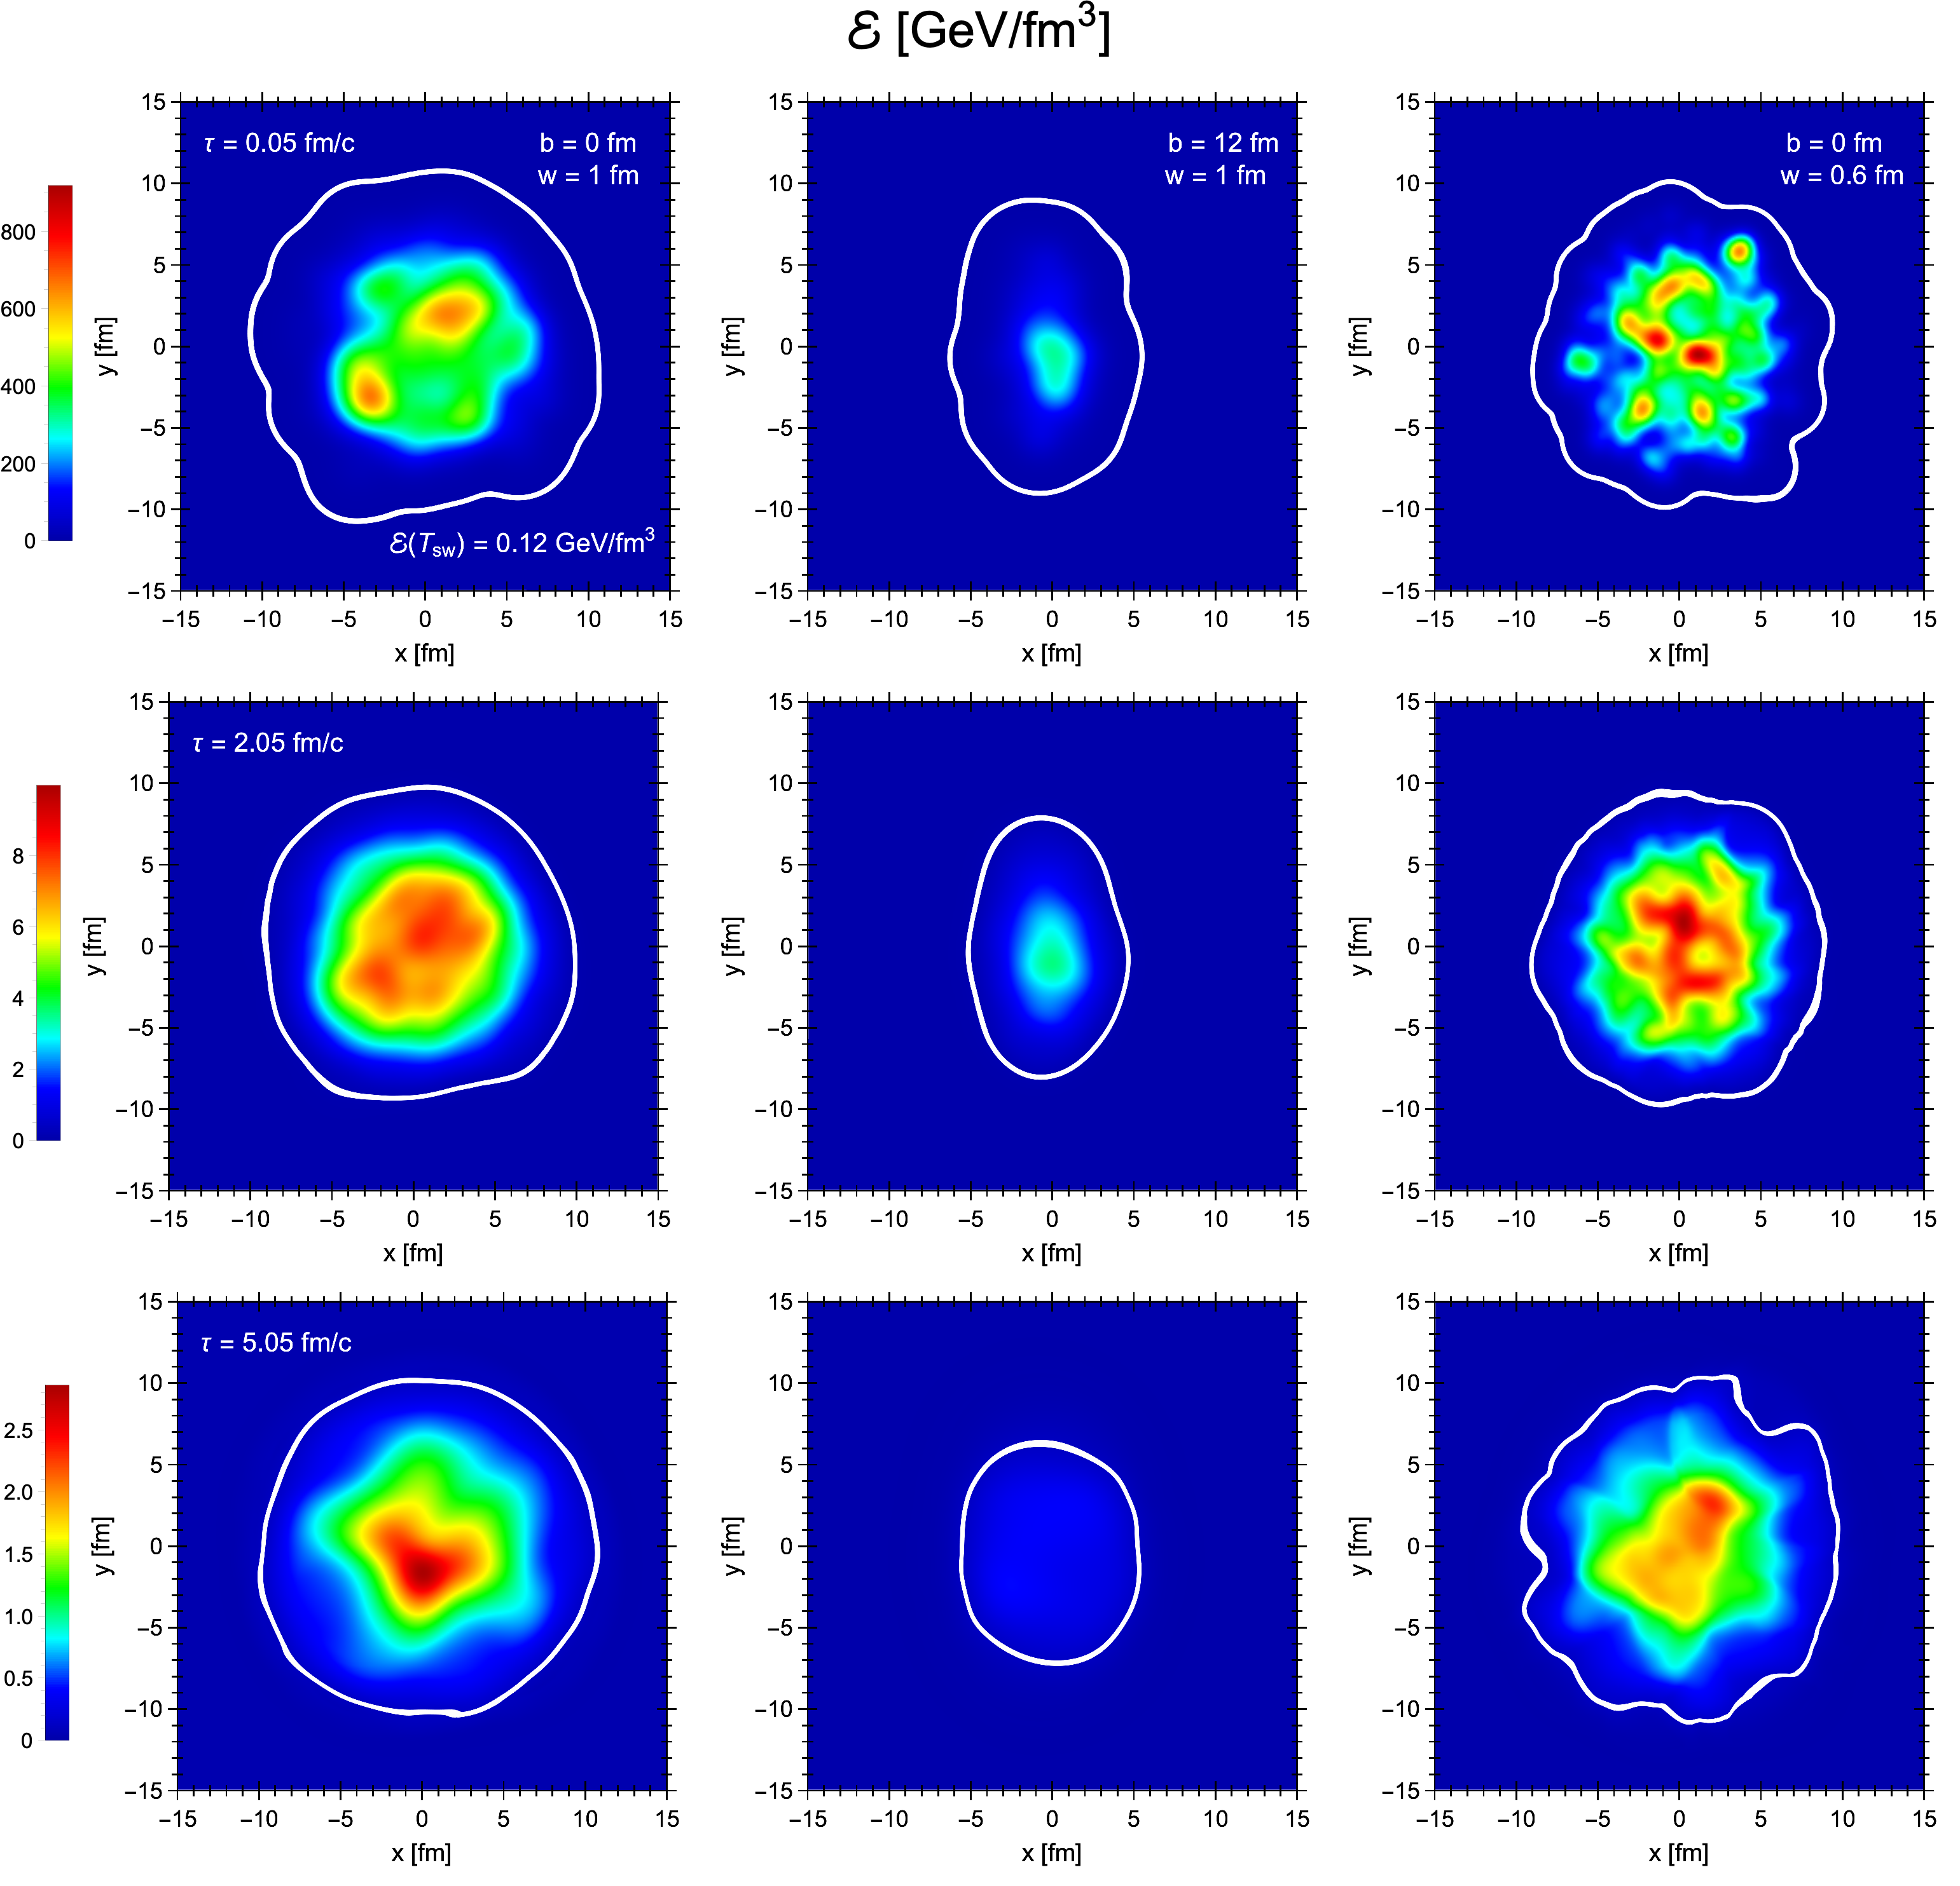

Overview
Quark-gluon plasma fireballs created in heavy-ion collisions come in different sizes
Impact parameter b
Transverse separation between colliding nuclei
14 simulation model parameters
T_{sw} = boundary temperature (fireball > T_{sw})
w = nucleon width (controls width of hot spots)
How big to make the simulation grid?
Simple choice: fix a large grid 30 fm x 30 fm
Not ideal for peripherical collisions (center col.)
Train a multivariate regression model to predict the fireball size
Automatically minimize the grid size
Reduce time to run hydrodynamic simulations
$$→$$

Slide 3
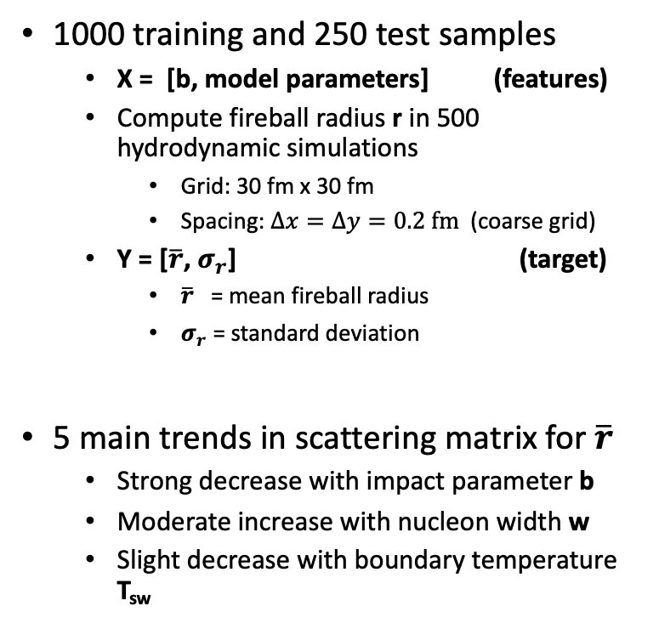
Data
1000 training and 250 test samples
X = [b, model parameters] (features)
Compute fireball radius r in 500 hydrodynamic simulations
Grid: 30 fm x 30 fm
Spacing: $Δx=Δy=0.2 fm$ (coarse grid)
Y = [$\overline{r}$, $σ_{r}$] (target)
$\overline{r}$ = mean fireball radius
$σ_{r}$ = standard deviation
5 main trends in scattering matrix for $\overline{r}$
Strong decrease with impact parameter b
Moderate increase with nucleon width w
Slight decrease with boundary temperature T_{sw}

Slide 4
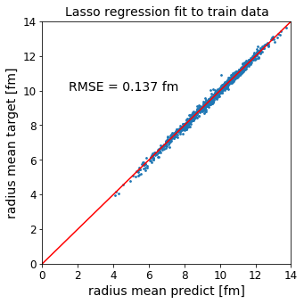
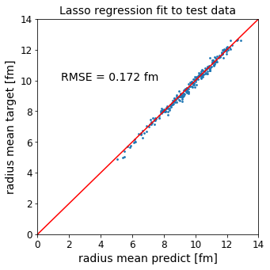
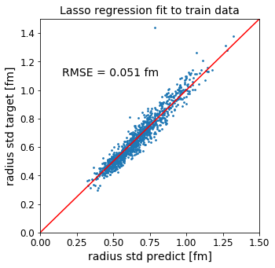
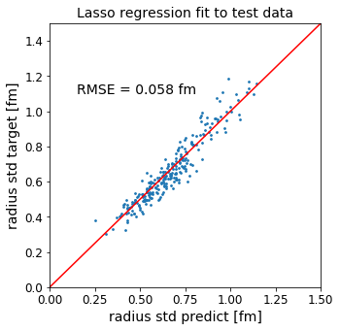
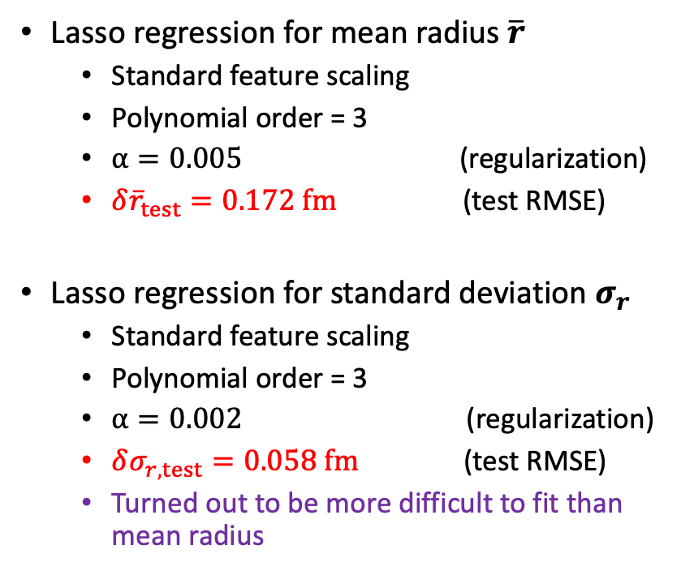
Regression model
Lasso regression for mean radius $\overline{r}$
Standard feature scaling
Polynomial order = 3
$α=0.005$ (regularization)
${δ\overline{r}}_{test}=0.172 fm$ (test RMSE)
Lasso regression for standard deviation $σ_{r}$
Standard feature scaling
Polynomial order = 3
$α=0.002$ (regularization)
$δσ_{r,test}=0.058 fm$ (test RMSE)
Turned out to be more difficult to fit than mean radius

Slide 5
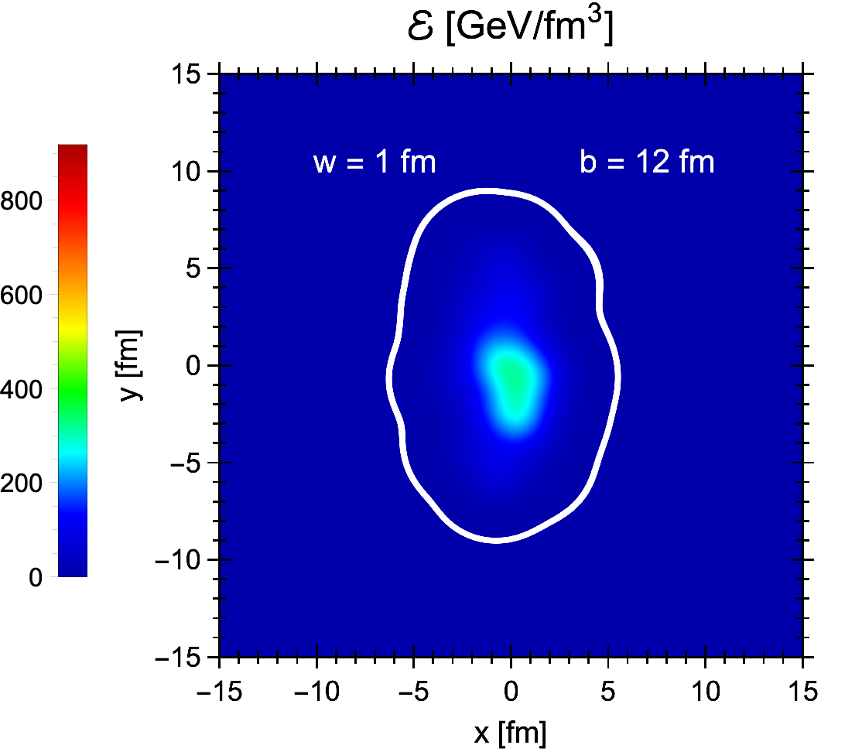
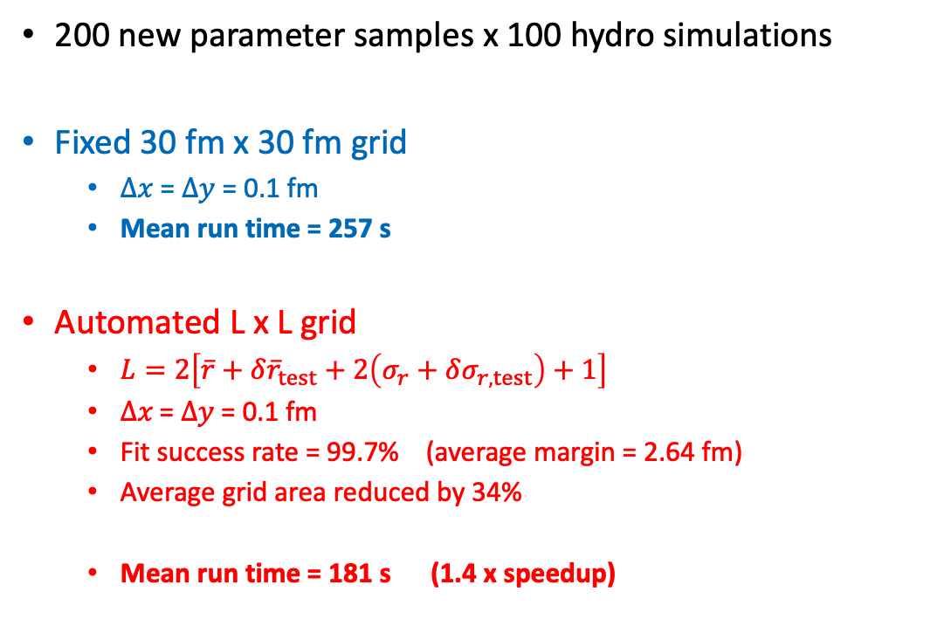
Configuring the grid size
200 new parameter samples x 100 hydro simulations
Fixed 30 fm x 30 fm grid
$Δx$ = $Δy$ = 0.1 fm
Mean run time = 257 s
Automated L x L grid
$L=2\left[\overline{r}+{δ\overline{r}}_{test}+2\left(σ_{r}+δσ_{r,test}\right)+1\right]$
$Δx\text{ = }Δy\text{ = 0.1 }\text{fm}$
Fit success rate = 99.7% (average margin = 2.64 fm)
Average grid area reduced by 34%
Mean run time = 181 s (1.4 x speedup)

Slide 6
Achievements and outlook
Achieved:
Developed a regression model that automatically configures hydrodynamic grid
2D hydro code runs about 1.4 times faster on auto grid compared to large fixed grid
Modest improvement but will prove useful when running heavy-ion simulations on a large scale
Outlook:
Improve regression fit on standard deviation
Train regression model on 3D hydro simulations (stands to benefit most)

Slide 7
Thank you!
Mike McNelis
mcnelis.9@osu.edu
Seyed Sabok-Sayr
saboksayr@physics.rutgers.edu
https://github.com/mjmcnelis/fireball
The Erdős Institute
2020 Data Science Boot Camp

